Slide 1
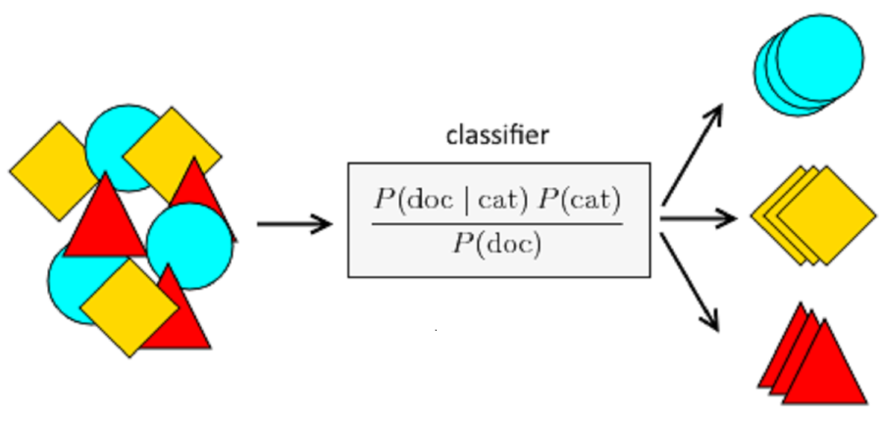

Naive Bayesian Classifier
A Naive Bayes classifier is a probabilistic machine learning model that’s used for classification task. The classifier is based on the Bayes theorem.

Slide 2
Naive Bayesian Classifier
Problem
Find a decision using the Naive Bayesian Classifier whether play will be started or not for the input tuple,
X= (Outlook=sunny, Temperature=mild, Humidity=normal, Wind =false)
Records | Outlook | Temperature | Humidity | Windy | Play
R1 | Sunny | Hot | high | False | Yes
R2 | Sunny | Hot | high | true | No
R3 | overcast | Hot | high | False | Yes
R4 | Rainy | mild | high | False | Yes
R5 | Rainy | cool | normal | False | Yes
R6 | overcast | cool | normal | true | Yes
R7 | Sunny | mild | high | False | No
R8 | Sunny | cool | normal | False | Yes
R9 | Rainy | mild | normal | False | No
R10 | Sunny | mild | normal | true | Yes
R11 | overcast | mild | high | true | Yes
R12 | overcast | hot | normal | False | Yes
R13 | Rainy | mild | high | true | No
R14 | Sunny | cool | high | False | Yes

Slide 3

Naive Bayesian Classifier
Answer:
Here,
c1=yes, c2= no
X1=sunny, X2=mild, X3=normal, X4=false
We know that,

Slide 4
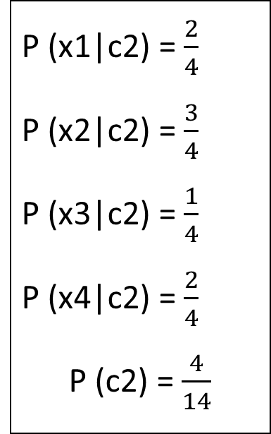
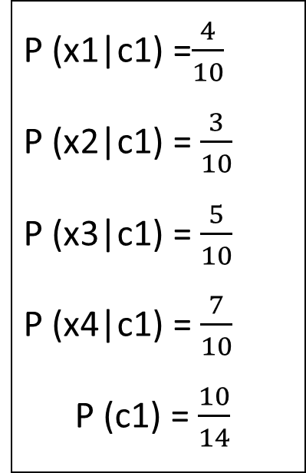
Naive Bayesian Classifier
P (x1|c1) =$\frac{4}{10}$
P (x2|c1) =$\frac{3}{10}$
P (x3|c1) =$\frac{5}{10}$
P (x4|c1) =$\frac{7}{10}$
P (c1) =$\frac{10}{14}$
P (x1|c2) =$\frac{2}{4}$
P (x2|c2) =$\frac{3}{4}$
P (x3|c2) =$\frac{1}{4}$
P (x4|c2) =$\frac{2}{4}$
P (c2) =$\frac{4}{14}$

Slide 5

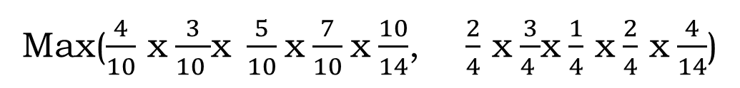
Naive Bayesian Classifier
Max($\frac{4}{10}$ x$\frac{3}{10 }$x$\frac{5}{10}$x$\frac{7}{10}$x$\frac{10}{14}$, $\frac{2}{4}$ x$\frac{3}{4 }$x$\frac{1}{4}$ x$\frac{2}{4}$ x$\frac{4}{14}$)
So, P (C|x1, x2, x3, x4)
So, Output class Argmax C = c1 = yes

Slide 6
Naive Bayesian Classifier (Laplace Correction)
Why Laplace Correction Needed?
A zero probability cancels the effects of all the other (posteriori) probabilities. Which is unfair? That’s why Laplace correction is needed.
Problem
Check whether the following text is computer or mathematics related using the Naive Bayesian classifier.
Words | Sqrt | Bit | Chip | Class
Doc1 | 40 | 20 | 0 | Math
Doc2 | 0 | 28 | 45 | Comp
Doc3 | 0 | 25 | 22 | Comp
Doc4 | 33 | 40 | 0 | Math
Doc5 | 28 | 32 | 0 | Math
Doc6 | 0 | 22 | 30 | Comp

Slide 7
Naive Bayesian Classifier (Laplace Correction)
Answer:
Here,
C1=Math, c2=Comp
X1=Sqrt, x2=Bit, x3=Chip
We know that,

Slide 8
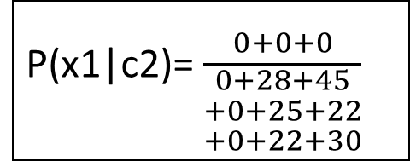
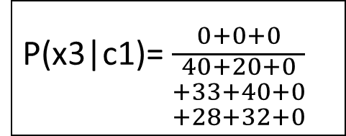
Naive Bayesian Classifier (Laplace Correction)
Here,
Training Data
Words | Sqrt | Bit | Chip | Class
Doc1 | 40 | 20 | 0 | Math
Doc2 | 0 | 28 | 45 | Comp
Doc3 | 0 | 25 | 22 | Comp
Doc4 | 33 | 40 | 0 | Math
Doc5 | 28 | 32 | 0 | Math
Doc6 | 0 | 22 | 30 | Comp
P(x3|c1)=$\frac{0+0+0}{\begin{aligned}40+20+0 \\ +33+40+0 \\ +28+32+0\end{aligned}}$
P(x1|c2)=$\frac{0+0+0}{\begin{aligned}0+28+45 \\ +0+25+22 \\ +0+22+30\end{aligned}}$
So, Laplace correction is needed for (Chip/Math) and (Sqrt/Comp)

Slide 9
Naive Bayesian Classifier (Laplace Correction)
Laplace Crrection Data
Words | Sqrt | Bit | Chip | Class
Doc1 | 40 | 20 | 0 | Math
Doc2 | 0 | 28 | 45 | Comp
Doc3 | 0 | 25 | 22 | Comp
Doc4 | 33 | 40 | 0 | Math
Doc5 | 28 | 32 | 0 | Math
Doc6 | 0 | 22 | 30 | Comp
Doc7 | 1 | 1 | 1 | Math
Doc8 | 1 | 1 | 1 | Comp

Slide 10
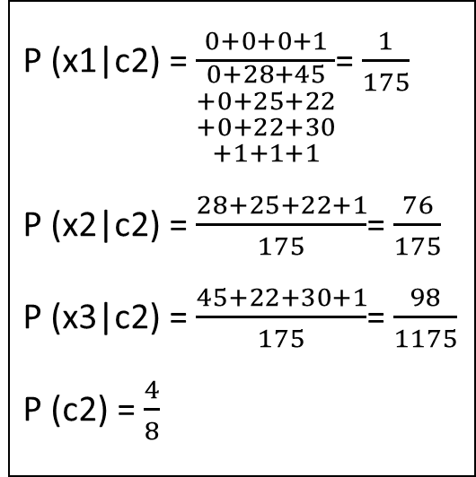
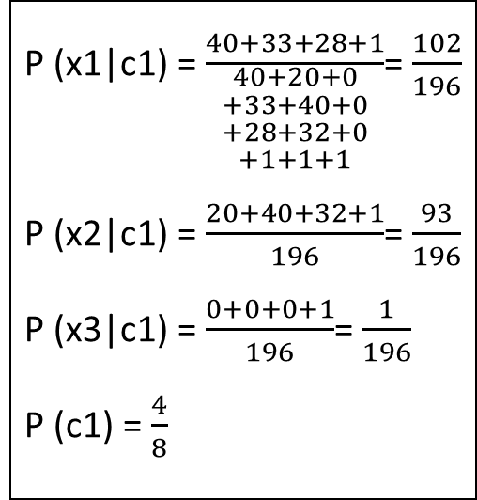
Naive Bayesian Classifier (Laplace Correction)
So,
P (x1|c1) =$\frac{40+33+28+1}{\begin{aligned}40+20+0 \\ +33+40+0 \\ +28+32+0 \\ +1+1+1\end{aligned}}$=$\frac{102}{196}$
P (x2|c1) =$\frac{20+40+32+1}{196}$=$\frac{93}{196}$
P (x3|c1) =$\frac{0+0+0+1}{196}$=$\frac{1}{196}$
P (c1) =$\frac{4}{8}$
P (x1|c2) =$\frac{0+0+0+1}{\begin{aligned}0+28+45 \\ +0+25+22 \\ +0+22+30 \\ +1+1+1\end{aligned}}$=$\frac{1}{175}$
P (x2|c2) =$\frac{28+25+22+1}{175}$=$\frac{76}{175}$
P (x3|c2) =$\frac{45+22+30+1}{175}$=$\frac{98}{1175}$
P (c2) =$\frac{4}{8}$

Slide 11


Naive Bayesian Classifier (Laplace Correction)
So, Output class Argmax C=c2=Comp

